Slide 1
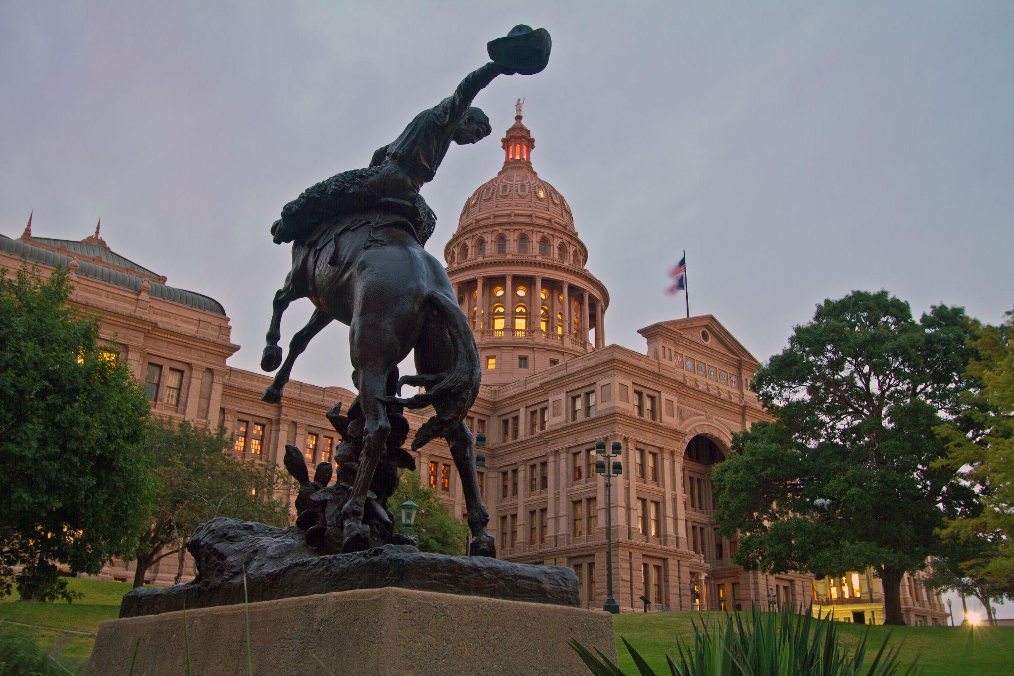
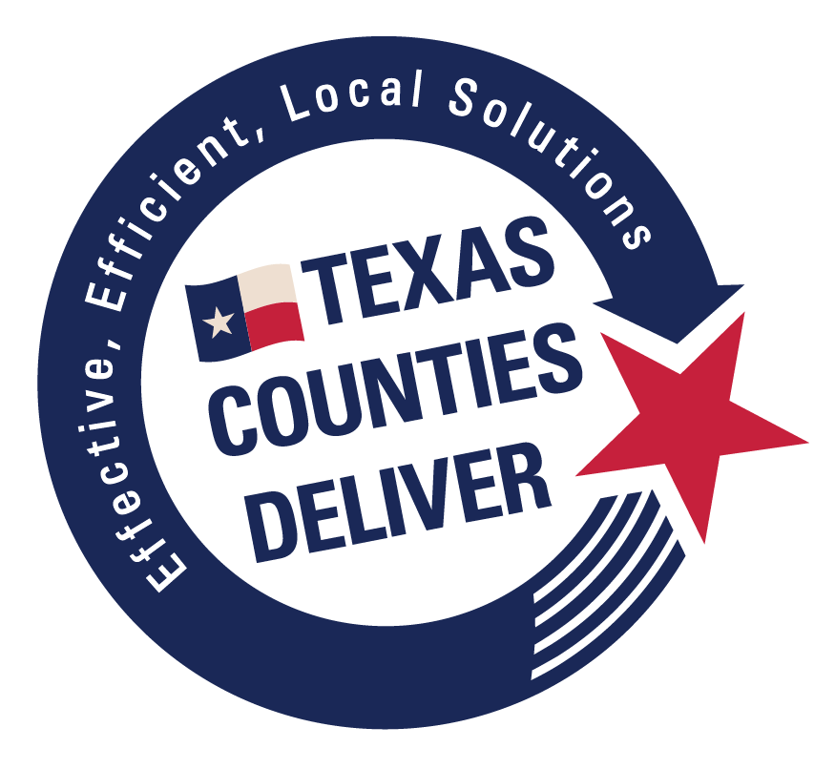
The Structure of Texas Counties
Notes:
So here’s the bottom line. While each county office functions independently, county government works best when all the offices work together. That’s why you don’t see as much politics in the county courthouse as you see in Austin and Washington. County officials have to participate in the political process to get elected, but once we’re in office, we have a responsibility to work together to deliver services to you – without regard to partisan politics.

Slide 2
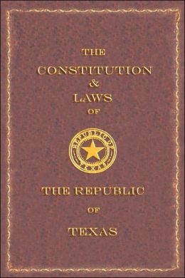
“The Republic
shall be divided into convenient counties…”
Art. IV, Constitution of the Republic of Texas
Notes:
Texas counties have been around as long as Texas has been around. When Texas won its independence, the 23 local governments that had existed under Mexican authority became the first 23 Texas counties. To further organize and develop the new republic, more counties were created. By the time Texas became a state in 1845, there were 36 counties. And of course, today there are 254, which is by far the largest number of counties in any state.

Slide 3
Why Counties Were Created?
Fear of government power
resulted in today’s system
of checks and balances.
Original Purpose:
Law & Order
Notes:
You may sometimes wonder why the county does things the way it does. More times than not, the answer to that is very simple. It’s the law. It’s how and why we were created. The original purpose of counties, and still one of our basic functions, was to provide a system for law and order. And no other level of government has as strong a system of checks and balances as your county.

Slide 4
Structure of Texas Counties
Counties are political subdivisions of the state.
Counties are extensions of state government at the local level.
Counties are “instrumentalities of the state” as opposed to municipalities.
Notes:
There is often a misconception that counties have the same general authority as cities. But that is far from the case. Counties are basically extensions of the state government at the local level. Unlike cities, counties are NOT municipalities. Generally speaking, cities have the ability to make their own local laws and ordinances, as long as they do not conflict with state or federal law. Counties do not have that same authority. Counties can only do things they are specifically authorized to do by the Texas Constitution and Statutes.

Slide 5
How Counties Function
Each office’s operations is governed by a variety of laws.
Each elected official has exclusive authority over the office’s operations and employees.
Commissioners Court controls the budget.
Commissioners Court may not use its budgetary authority to prevent an officer from performing his/her required duties.
Notes:
There is often a misconception that counties have the same general authority as cities. But that is far from the case. Counties are basically extensions of the state government at the local level. Unlike cities, counties are NOT municipalities. Generally speaking, cities have the ability to make their own local laws and ordinances, as long as they do not conflict with state or federal law. Counties do not have that same authority. Counties can only do things they are specifically authorized to do by the Texas Constitution and Statutes.

Slide 6
The Bottom Line
While each county office functions independently, county government works best when all offices work together.
Notes:
So here’s the bottom line. While each county office functions independently, county government works best when all the offices work together. That’s why you don’t see as much politics in the county courthouse as you see in Austin and Washington. County officials have to participate in the political process to get elected, but once we’re in office, we have a responsibility to work together to deliver services to you – without regard to partisan politics.

Slide 7
County Services
Build and Maintain Roads
Notes:
Counties deliver many different services that you depend on. Some of these services are core functions of all counties, while others are optional but important nonetheless. Obviously, one of the major responsibilities of counties is the provision and maintenance of county roads.

Slide 8
County Services
Public Safety
Notes:
Counties deliver many different services that you depend on. Some of these services are core functions of all counties, while others are optional but important nonetheless. Obviously, one of the major responsibilities of counties is the provision and maintenance of county roads.

Slide 9
County Services
Justice System
Notes:
You can’t have law and order without an effective court system. On the criminal side, the courts provide the system to administer justice. On the civil side, the courts give us the means to resolve disputes in a peaceful manner. The county is responsible for the operation of the state court system. This includes everything from Justice of the Peace Court to County Court (County Court at Law if applicable), and District Court. While the state pays a relatively small portion of the cost – mainly the salaries of the District Judge and District Attorney -- the county bears most of the expense of operating our state court system.

Slide 10
County Services
Record Safety
Notes:
Another extremely important function that helps maintain order in our society is the recording of documents such as deeds, birth certificates, death certificates, marriage licenses, wills and other instruments. Once again, counties deliver! Can you imagine the chaos if we did not have an effective system for recording all these records? The story of your life, and the history of your family, is recorded at the courthouse.

Slide 11
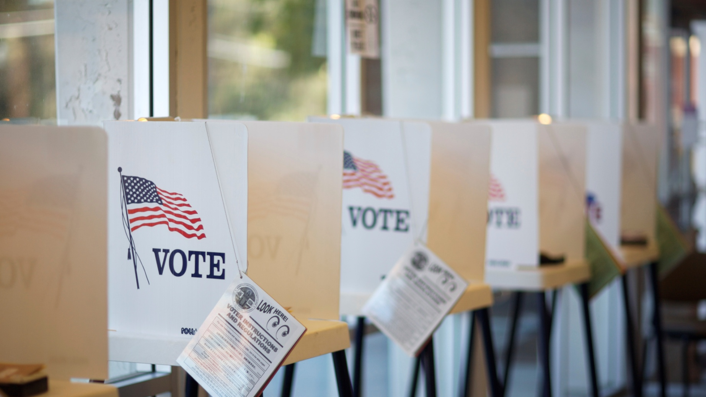
County Services
Hold All Elections
Notes:
Counties are responsible for conducting elections – and not just elections for county offices, but state and federal elections as well. This entails everything from voter registration to drawing the lines for voting precincts, to holding the election and counting the ballots and certifying the results.

Slide 12
County Services
Emergency Management
Notes:
Counties have a very important role to play in emergency management. Like many other states, Texas employs an emergency management structure that moves from the ground level upward to the state level, as required by the extent of the disaster. Under Texas law, the County Judge serves as emergency management director, and has the authority to declare a local state of emergency. During an emergency, the local governments are expected to use their own resources first. If local resources are insufficient, the county may request help from the state. In emergency management, the first goal is to prevent a disaster from occurring. A burn ban is a good example of a preventive measure. The next goal is to be prepared for when something occurs, ready to respond to the disaster, and recover from its effects.

Slide 13
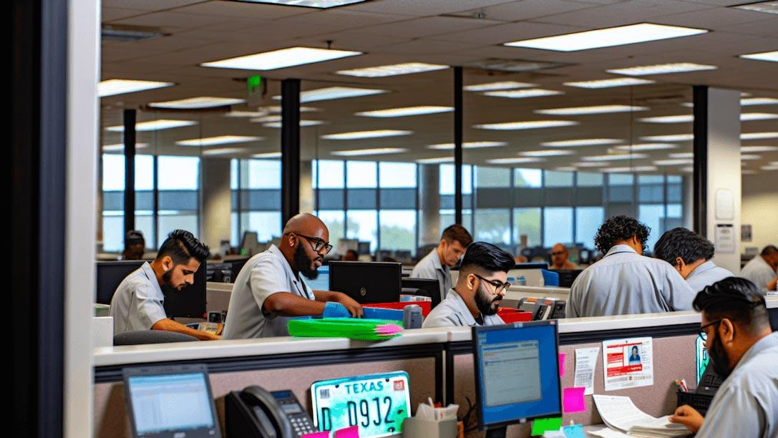
County Services
Registering Vehicles
Notes:
Registration of motor vehicles, boats and trailers is another important function that counties provide for the state. Even though you pay these fees to the county, remember that the county keeps only a small portion. Most of it goes to the state.

Slide 14
County Services
Health and Safety Services
Notes:
Under Texas law, counties are responsible for indigent health care. (If a hospital district exists within the county, then the hospital district is responsible to provide this care for the residents of that district.)

Slide 15
Commissioners Court
Responsible for budget and tax rate.
Approves all budgeted purchases.
Sets all salaries and benefits.
Has exclusive authority to approve contracts.
Provides & maintains all buildings.
Fills vacancies in most other offices.
Notes:
Let’s look at the various county offices and their responsibilities. The Commissioners Court is the body that conducts the general business of the county. It’s made up the four County Commissioners and the County Judge. While the Judge is the presiding officer, all five members have an equal voice and an equal vote. The Court is responsible for adopting the county’s budget and setting the tax rate necessary to fund the budget. The Court also approves all purchases, is responsible for providing and maintaining all county buildings, and has exclusive authority to approve contracts for the county. The Court sets all salaries. However, it does not have authority to choose the personnel who work in the other county offices.

Slide 16
County Judge
Responsible for budget and tax rate.
Presiding officer of the Commissioners Court.
Represents the county in many administrative functions.
Serves as budget officer in most counties.
Serves as head of emergency management.
Has broad judicial duties in criminal and civil cases.
Notes:
The County Judge is the presiding officer of the Commissioners Court and wears many other hats. In most counties, he or she serves as the budget officer and is responsible for drafting the proposed budget which is then subject to the action of the full Commissioners Court. The Judge serves as the director of emergency management. And in most counties, the Judge has broad judicial duties that include presiding over more serious misdemeanor cases and civil cases where up to $10,000 is in dispute. Most County Judges hear probate matters such as wills and guardianships, and also hear appeals from the Justice of the Peace Court.

Slide 17
County Commissioner
Represents one of four precincts.
Responsible for budget and tax rate.
Has broad policy-making authority as a member of the Commissioners Court.
Typically responsible for building and maintaining roads and bridges and other county facilities within their precinct.
Notes:
County Commissioners have broad policy making authority as members of the Commissioners Court. In addition, in counties that have the precinct road and bridge system in place, each Commissioner is responsible for building and maintaining the county roads and bridges within his or her precinct.

Slide 18
Tax Assessor-Collector
Collects property taxes.
May contract to collect for other local entities.
Registers motor vehicles for the state.
Collects various other fees for the state and county.
Serves as voter registrar.
Calculates the No New Revenue rate.
Notes:
Duties can vary from county to county, but in most instances, the County Tax Assessor-Collector is responsible for assessing and collecting property taxes, registering motor vehicles, and conducting voter registration. The Tax Assessor-Collector usually handles other tax-related functions like calculating the effective tax rate each year. One thing the Tax Assessor-Collector does NOT do is decide how much your property is appraised for. All property appraisals are done by the Central Appraisal District, which is a separate entity from the county.

Slide 19
County Clerk
Serves as clerk and custodian of records for Commissioners Court and other county courts.
Recorder and custodian of important records like deeds, bonds, birth and death certificates, livestock brands, etc.
Issues marriage licenses.
Serves as chief elections officer in most counties.
Notes:
The County Clerk serves as the clerk and custodian of records for the Commissioners Court, the Constitutional County Court, and in counties that have them, the County Courts at Law. The County Clerk is the official recorder and custodian of many important public records, including bonds, deeds, birth and death certificates, assumed names and livestock brands. This office also issues birth certificates, death certificates and marriage licenses. And in most counties, the County Clerk serves as the chief elections officer.

Slide 20
District Clerk
Serves as clerk and custodian of all records for district courts.
Coordinates the jury panel selection process.
Manages court registry and trust funds.
May process passport applications.
Notes:
The District Clerk is the official clerk and custodian for all the records of the district courts. As part of this process, this office handles trust funds held in the registry of the court. Another important function is to coordinate the selection and summoning of jury panels. Many District Clerks also process passport applications. All counties with a population of more than 8,000 have a separate County Clerk and District Clerk, but most counties under 8,000 have a combination County and District Clerk who performs the functions of both offices.

Slide 21
County Treasurer
Receives and deposits all county revenues.
Chief liaison between the county and banks.
Disburses funds upon the order of the Commissioners Court.
Prepares the payroll.
Often serves as HR coordinator.
Notes:
You can think of the County Treasurer as the county’s banker. The Treasurer receives and deposits all county funds, acts as the chief liaison between the county and its depository bank, and reconciles bank statements. The Treasurer disburses funds on order of the Commissioners Court and records receipts and expenditures. Many Treasurers process the county payroll, and many are designated as the county’s investment officer. Treasurers also have some audit responsibilities in counties with no auditor.

Slide 22
Sheriff
Serves as the chief law enforcement officer.
Manages and operates the county jail.
Provides security for the courts.
Serves warrants and civil papers.
Regulates bail bondsmen in many counties.
Notes:
The Sheriff is the county’s chief law enforcement official, and is responsible for the operation of the county jail. The Sheriff also provides security for the courts, serves warrants and civil papers, and regulates bail bondsmen in counties where a Bail Bond Board has not been created. In many counties with fewer than 8,000 residents, the Sheriff also serves as the Tax Assessor-Collector.

Slide 23
Justice of the Peace
Hears Class C misdemeanor cases.
Hears civil cases up to $20,000.
Hears landlord and tenant disputes.
Serves as magistrate.
Conducts inquests.
Notes:
The Justice of the Peace hears all Class C misdemeanor cases, which are those cases that are punishable by fine only. JP’s also hear civil cases with up to $20,000 in dispute, and handle landlord-tenant disputes. The Justice of the Peace performs magistrate duties, which include informing those arrested of their rights and setting their bond. Except in the largest counties which have their own Medical Examiner’s office, Justices of the Peace also conduct inquests.

Slide 24
Constable
Serves as a licensed peace officer and performs various law enforcement functions.
Serves warrants and civil papers such as subpoenas and restraining orders.
Serves as bailiff for the Justice Court.
Notes:
The Constable is a licensed peace officer and performs a wide variety of law enforcement functions. Constables serve as bailiff for the Justice of the Peace Court, and serve warrants and civil papers such as subpoenas and restraining orders.

Slide 25
County Attorney
Represents the state in the prosecution of misdemeanor cases.
Investigates misdemeanor cases.
Legal advisor to other county officials.
Brings civil enforcement actions on behalf of the state or county.
Notes:
The County Attorney represents the state in the prosecution of misdemeanor criminal cases and works with law enforcement to investigate those cases. He or she also provides legal advice to the other county officials, and can bring civil enforcement actions on behalf of the state or county.

Slide 26
District Attorney
Represents the state in the prosecution of felonies.
Investigates felony cases.
Presents cases to the grand jury.
Represents the state in child welfare cases.
Represents victims of violence.
Notes:
The District Attorney represents the state in felony criminal cases, and works with law enforcement to investigate those. The DA presents cases to the grand jury, represents victims of violence in protective orders, and represents the state in child welfare cases. In some counties, the functions of the County Attorney and District Attorney are combined into one office, which is called either the Criminal District Attorney, or the County and District Attorney.

Slide 27
County Auditor
Appointed by the District Judge(s).
Required if population is over 10,200.
Serves as the county’s chief accountant and watchdog.
Verifies the validity and legality of all payments.
Forecasts financial data for budgets.
Serves as budget officer in some counties.
Notes:
The County Auditor is the only one of these officials who is not elected, but is appointed by the District Judges. The auditor is required in counties with a population over 10,200. You can think of the Auditor as the “watchdog”. He or she is charged with verifying the validity and legality of all county expenditures. The Auditor plays a significant role in the budget process, providing financial data and forecasting revenues. And In counties with a population over 225,000, the Auditor serves as the budget officer, unless the county has established a separate position for that function.

Slide 28
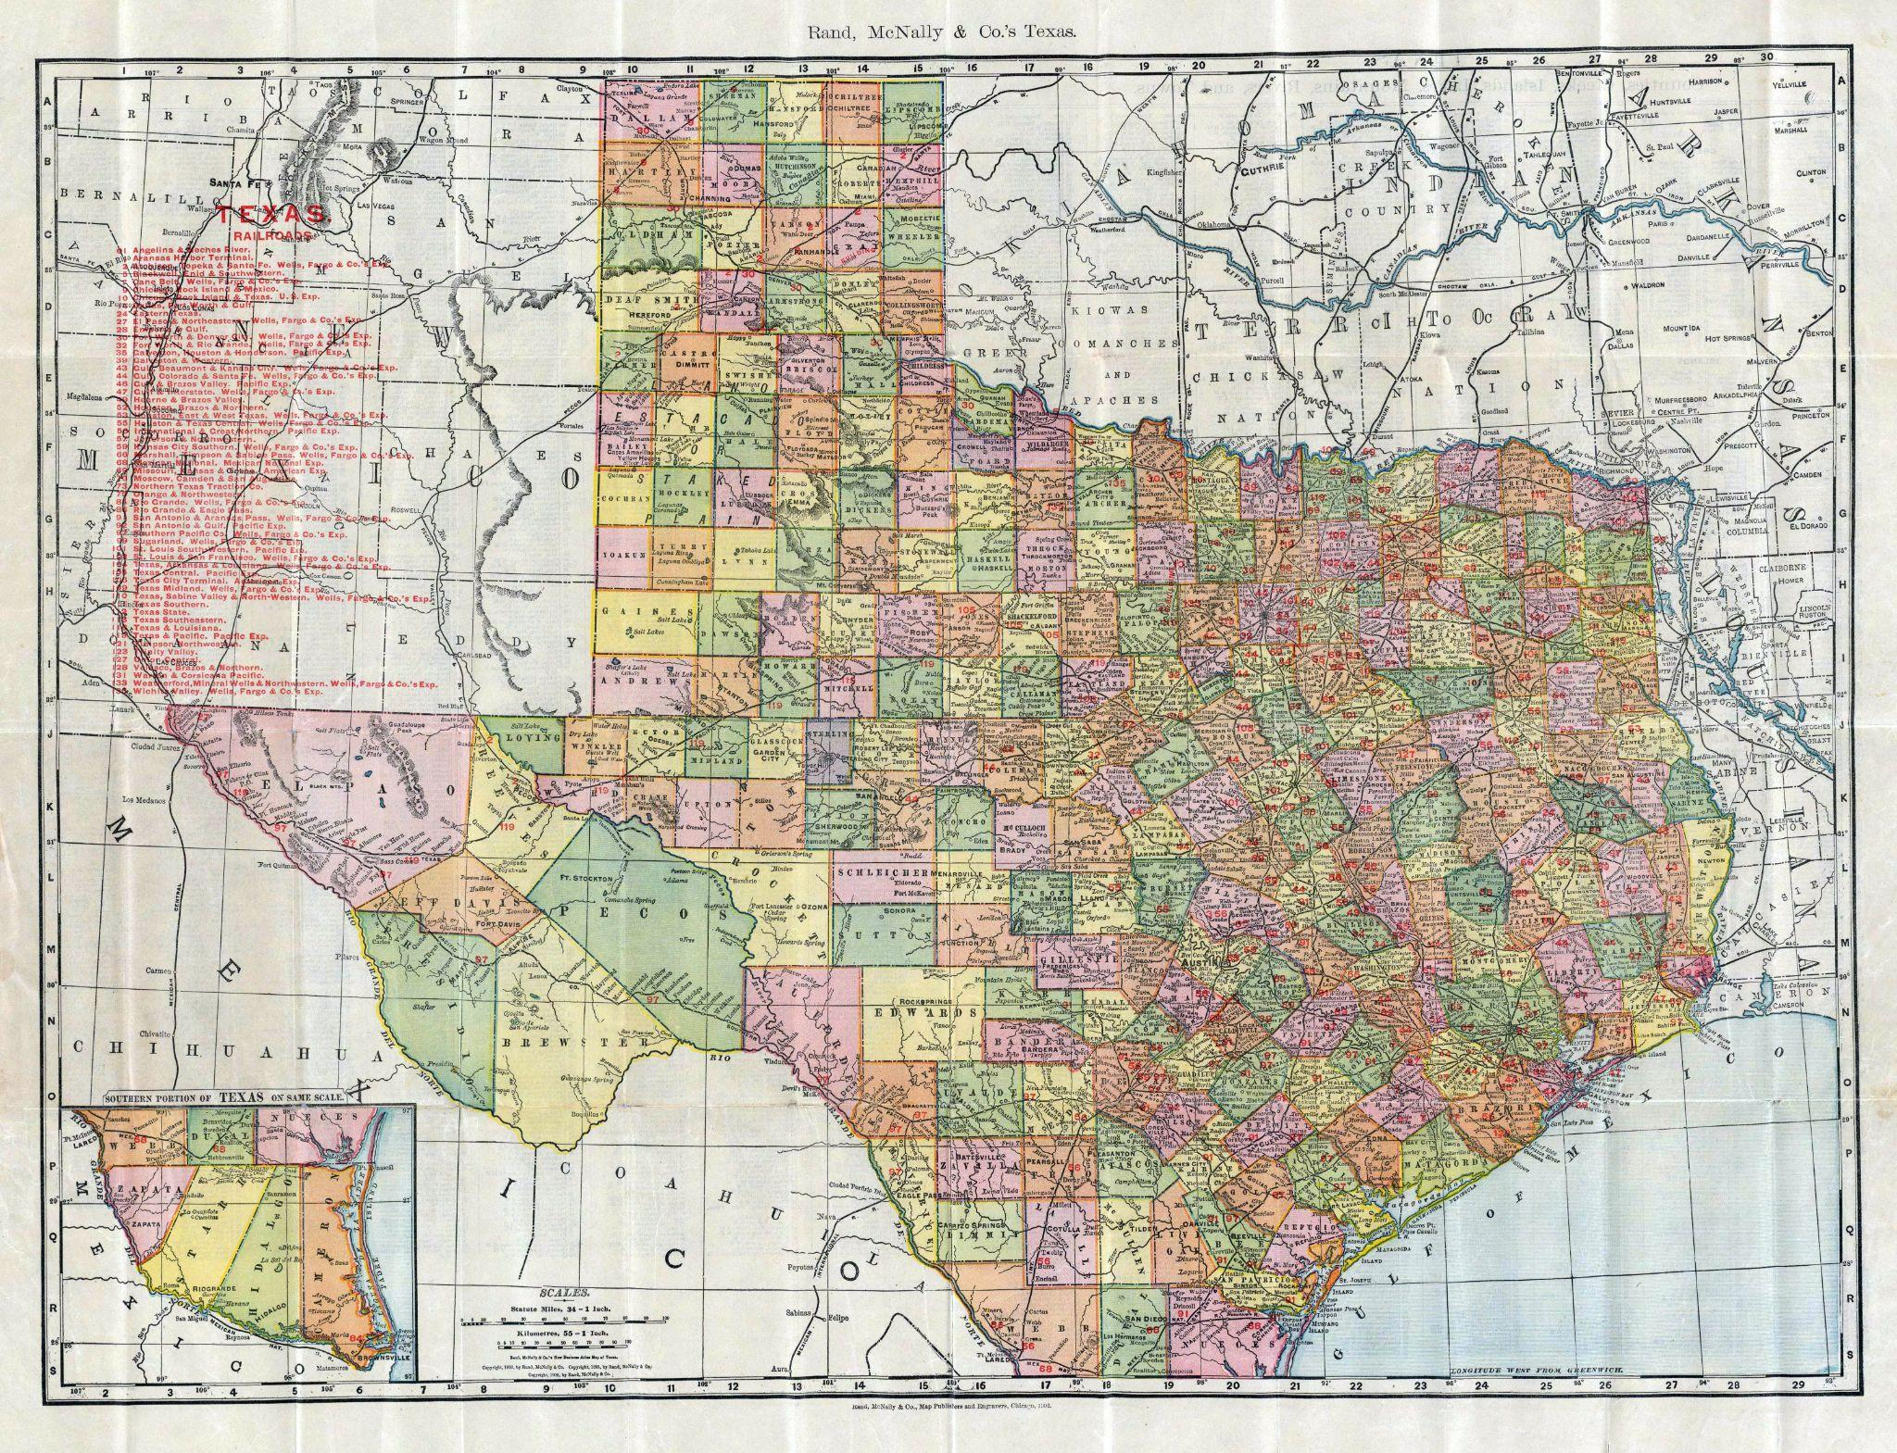
One Size Does Not Fit All.
Notes:
County government is the most effective -- and most efficient -- level of government we have. Why do you suppose that is? One of the main reasons is the fact that we have all these different county officials – people you know, who you elect – working for you and working among you – and making decisions right here at home. Each county is unique. What works best for one may not work best for all. In fact it seldom does. And frankly, we need your help to maintain our system of local self-governance. We have great respect for our leaders in Austin and Washington. But they can’t sit in Austin or Washington and know what’s best here in _________ County. So when they start trying to take authority away from your locally elected officials and consolidate more control at the state and federal level, we’re asking you to let them know you don’t support that. We need your support so we can continue to deliver these essential services for you and your family in the most effective and efficient way possible.

Slide 29
[Add your county’s contact information here.]
Notes:
So here’s the bottom line. While each county office functions independently, county government works best when all the offices work together. That’s why you don’t see as much politics in the county courthouse as you see in Austin and Washington. County officials have to participate in the political process to get elected, but once we’re in office, we have a responsibility to work together to deliver services to you – without regard to partisan politics.

